Slide 1
British Airways
By Sidharth Thazhathedathu

Slide 2
Food and beverages and cabin staff service are linked. Value for money is related to ground service and value for money as well as seat comfort.
759 reviews are verified among the 1000.

Slide 3
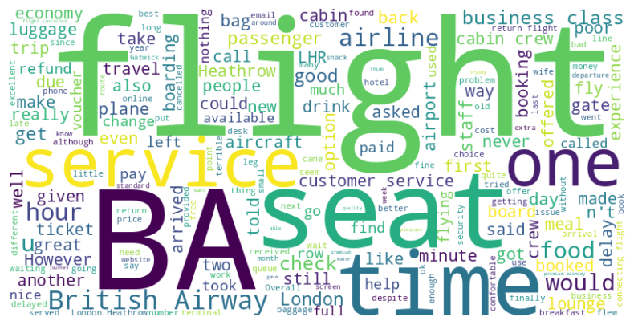

Slide 4
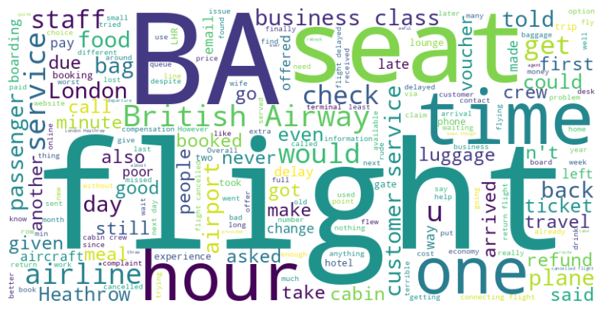
negative

Slide 5
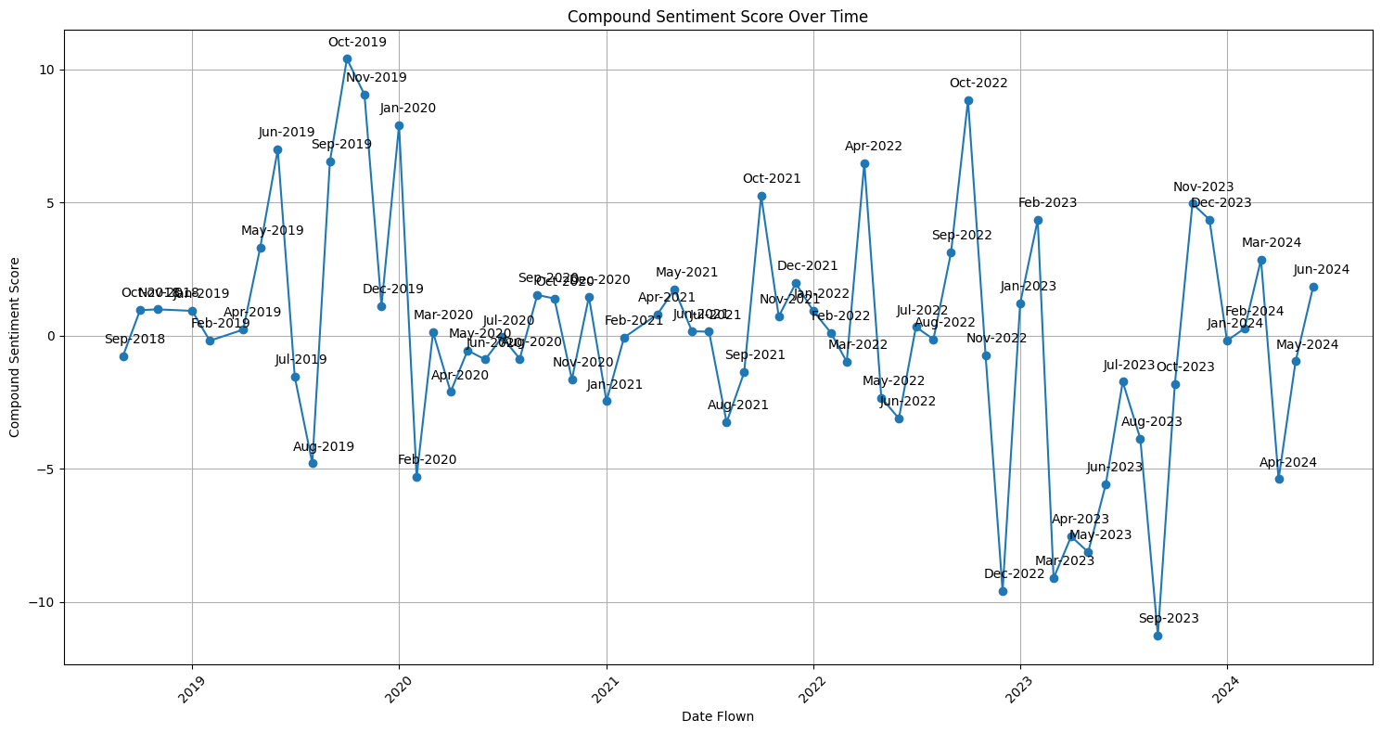
We can see that the compound score decreases from year 2019 to 2024 in a season trend. This could be because the number of reviews are lower during the pandemic time.

